Slide 1


<Miguel Angel Solano Valdez>
<June 28th, 2025>

Slide 2

Outline
Executive Summary
Introduction
Methodology
Results
Conclusion
Appendix

Slide 3
Executive Summary
The methodologies that were used:
Data Collection
Data Wrangling
EDA with visualization
EDA with SQL
Folium
Dashboards
Classification Algorithms and Grid Search Cross Validation
The model which performed the best was the Decision Tree Classifier.

Slide 4
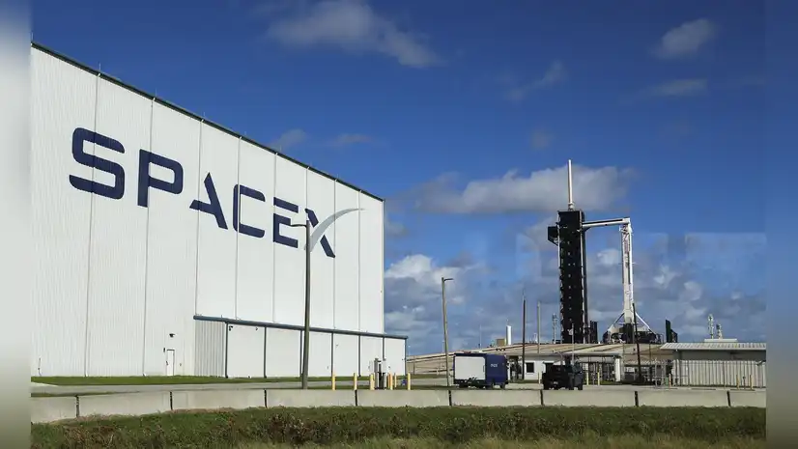
Introduction
In the era of affordable space travel, SpaceX provides:
Satellite Internet
Man missions.
Falcon 9 rocket launches reuses the first stage, and in turn, making them more affordable.
The first stage does the most work in the launch. Sometimes it will land, sometimes it will crash, other times it will be sacrificed.
The objective of the report is to create a machine learning model to predict if SpaceX will reuse the first stage.

Slide 5

Section 1

Slide 6
Methodology
Executive Summary
Data collection methodology:
Data was collected from SpaceX REST API and by web scrapping Wikipedia.
Perform data wrangling
Transform Falcon 9 Data from JSON to Data Frame with no null values
Perform exploratory data analysis (EDA) using visualization and SQL
Perform interactive visual analytics using Folium and Plotly Dash
Perform predictive analysis using classification models
The data was split into a train-test split. The models were Logistic Regression, Support Vector Machine, Decision Tree and K-Nearest Neighbors. The best model was the one that had the highest accuracy. Fe

Slide 7
Data Collection
SpaceX REST API provides data about launch including rocket use, payload delivered, launch specifications, landing specifications and landing outcome.
Scrapping the API’s URL and Wikipedia
Data wrangling from JSON to Data Frame
Sampling data for only Falcon 9 launches
Dealing with Null Values

Slide 8
Data Collection – SpaceX API
Result: Data Frame with 90 Falcon 9 Launches and 17 labels. No null values
SpaceX API Github
Get Request from Space X API returns JSON object
Parse the JSON object with pd.json_normalize
With preset functions, save the chosen features in a Data Frame
Filter for Falcon 9 launches and replace missing values with mean of column

Slide 9
Data Collection – Scrapping
Result: Data Frame with 121 Falcon 9 Launches and 11 labels. No null values
Data Collection Github
Get Request from Falcon9 Launch Wiki Page
Parse the HTML table with Beautiful Soup.
With preset functions, save the chosen features in a Data Frame
Filter for Falcon 9 launches and replace missing values with mean of column

Slide 10
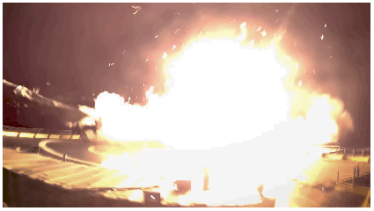
Data Wrangling
Once the data was stored into Data Frames, two tasks were performed:
Exploratory Data Analysis
The site with the highest number of launches was CCAFS SLC 40
The highest number of launches was sent to the GT 0rbit
Setting training labels
A class label was created. Values 0 and 1. 0 for bad outcome and 1 for good outcome
There were 66% successful launches.
Data Wrangling Notebook

Slide 11
EDA with Data Visualization
The charts used were
Scatterplot
Line Chart
They were used to explain the relationship between payload, launch site, flight number and outcome.
EDA with Data Visualization Notebook

Slide 12
EDA with SQL
Display the names of the unique launch sites in the space mission
Display 5 records where launch sites begin with the string 'CCA'
Display the total payload mass carried by boosters launched by NASA (CRS)
Display average payload mass carried by booster version F9 v1.1
List the date when the first successful landing outcome in ground pad was achieved.
List the names of the boosters which have success in drone ship and have payload mass greater than 4000 but less than 6000
EDA with SQL notebook

Slide 13
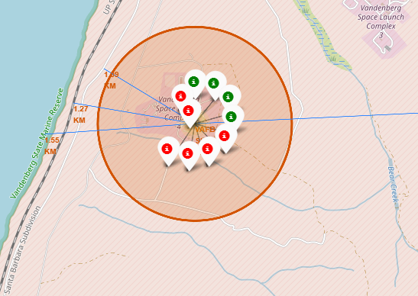
Build an Interactive Map with Folium
The following map objects were used:
Markers: They were used to mark the failed and successful launches, and text such as names.
Circles: They represent the radius of the launch sites.
Lines: They were used to measure and graph the distance between sites and other locations.
Folium Map on GitHub

Slide 14
Build a Dashboard with Plotly Dash
The dashboard includes elements like a Pie chart and a Scatterplot
The pie chart allowed to see the relation between Launch Sites and Success Rate
The Scatterplot allowed to see the relation
Add the GitHub URL of your completed Plotly Dash lab, as an external reference and peer-review purpose

Slide 15
Predictive Analysis (Classification)
The result was a decision tree classifier with 88% accuracy.
Predictive Analysis Notebook
Logistic Regression
KNN
SVM
Decision Tree
Test – Train Split with 0.2 test size
Grid Search to choose hyperparameters
Highest accuracy: Decision Tree

Slide 16

Section 2

Slide 17
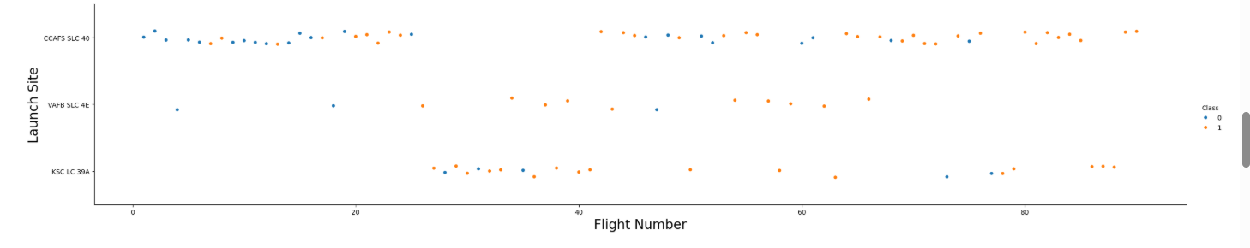
Flight Number vs. Launch Site
As the graph shows, most launches happen at the CCAFS SLC 40 Launch Site

Slide 18
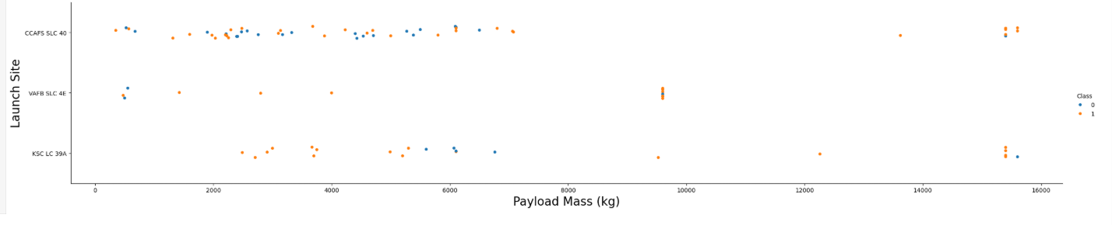
Payload vs. Launch Site
There are no heavy launches for the VAFB SLC 4E Launch Site.

Slide 19
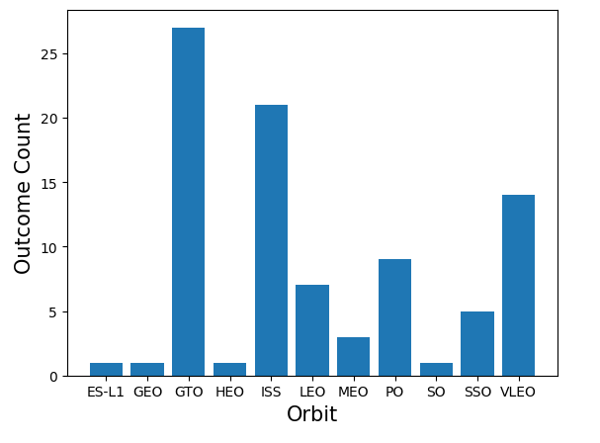
Success Rate vs. Orbit Type
The most successful launches are to GTO, ISS and VLEO.

Slide 20
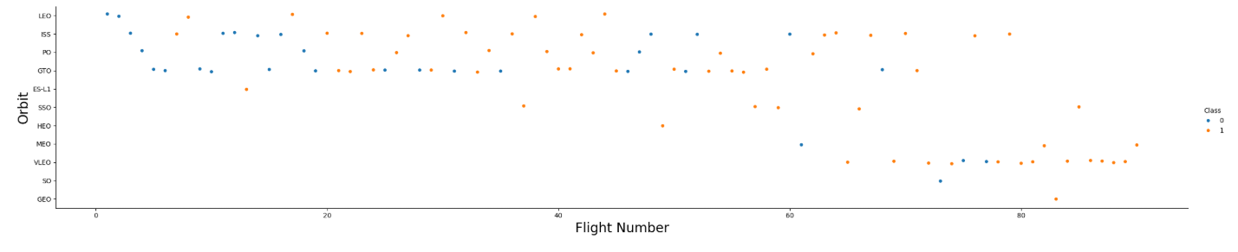
Flight Number vs. Orbit Type
The orbit VLEO sucess is related to the number of flights.

Slide 21
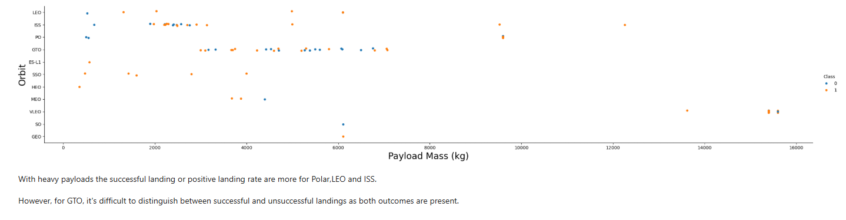
Payload vs. Orbit Type

Slide 22
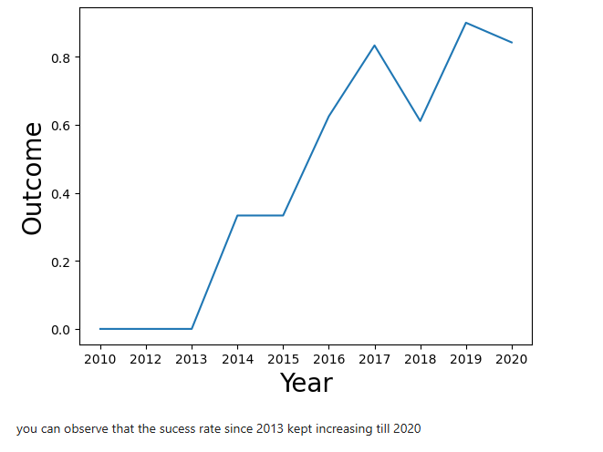
Launch Success Yearly Trend

Slide 23
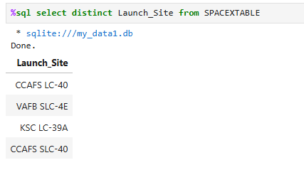
All Launch Site Names
Find the names of the unique launch site

Slide 24
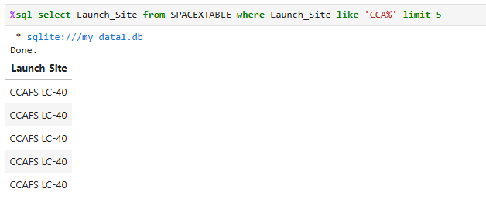
Launch Site Names Begin with 'CCA'
Find 5 records where launch sites begin with `CCA`

Slide 25
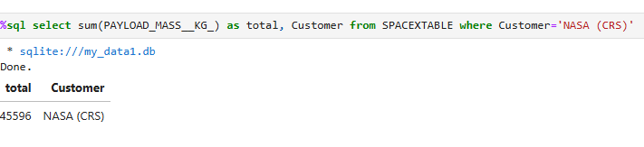
Total Payload Mass
Calculate the total payload carried by boosters from NASA

Slide 26
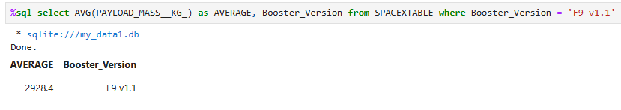
Average Payload Mass by F9 v1.1
Calculate the average payload mass carried by booster version F9 v1.1

Slide 27
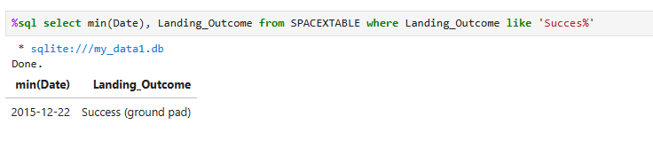
First Successful Ground Landing Date
Find the dates of the first successful landing outcome on ground pad

Slide 28
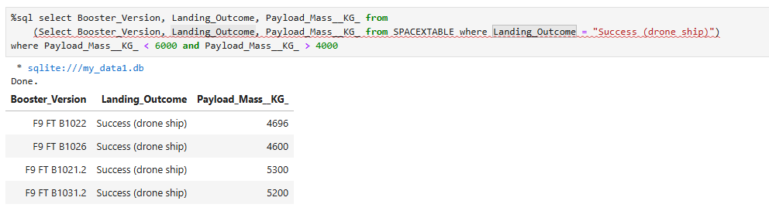
Successful Drone Ship Landing with Payload between 4000 and 6000
List the names of boosters which have successfully landed on drone ship and had payload mass greater than 4000 but less than 6000

Slide 29
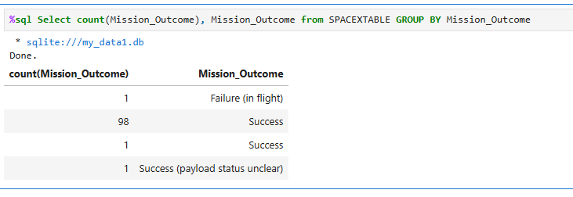
Total Number of Successful and Failure Mission Outcomes
Calculate the total number of successful and failure mission outcomes

Slide 30
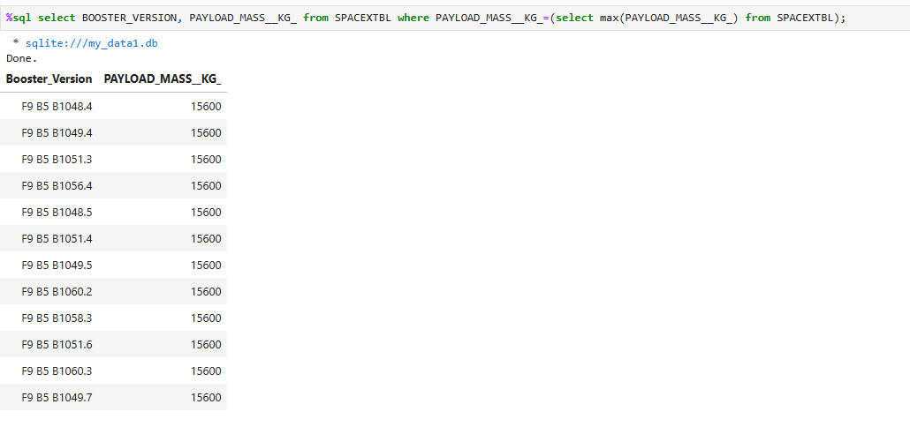
Boosters Carried Maximum Payload
List the names of the booster which have carried the maximum payload mass

Slide 31
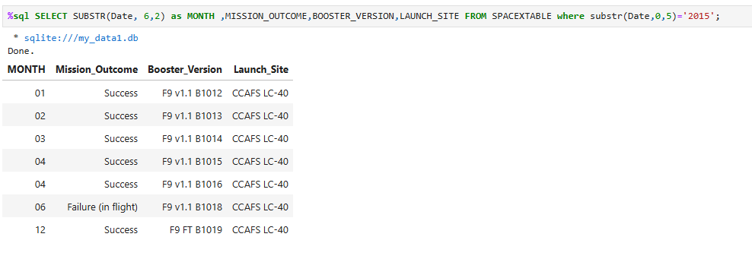
2015 Launch Records
List the failed landing_outcomes in drone ship, their booster versions, and launch site names for in year 2015

Slide 32
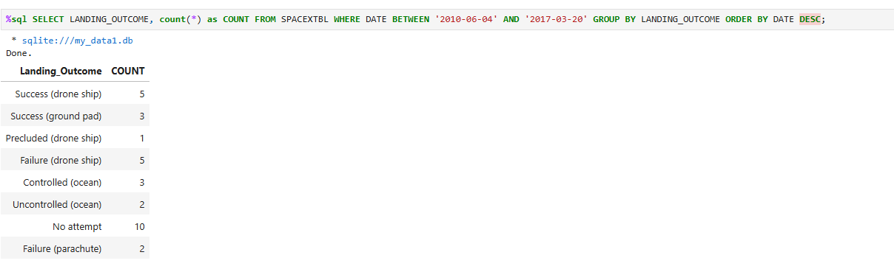
Rank Landing Outcomes Between 2010-06-04 and 2017-03-20
Rank the count of landing outcomes (such as Failure (drone ship) or Success (ground pad)) between the date 2010-06-04 and 2017-03-20, in descending order

Slide 33

Section 3

Slide 34
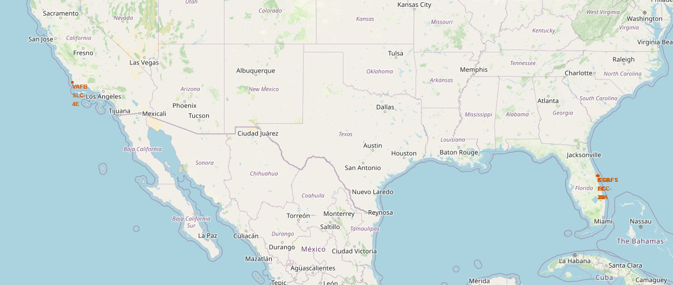
Launch Sites on Map
There are three launch sites:
One in California
VAFB SLC-4E
Three in Florida
KSC LC 39A
CCAFS SLC-40
CCAFS LC-40

Slide 35
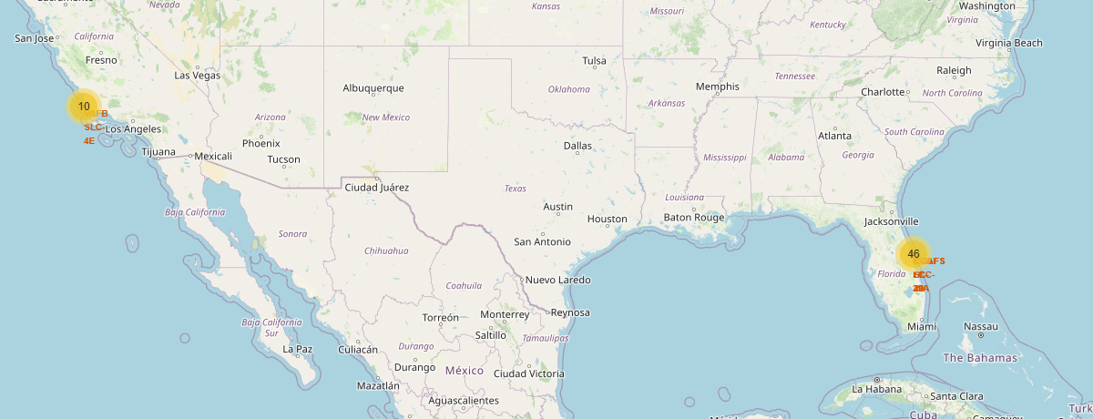
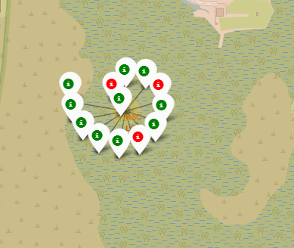
Success and failed launches for each site
The site with the most successful launches was KSC LC 39A in Florida.
The site with the most failed launches was CCAFS LC-40 in Florida.

Slide 36
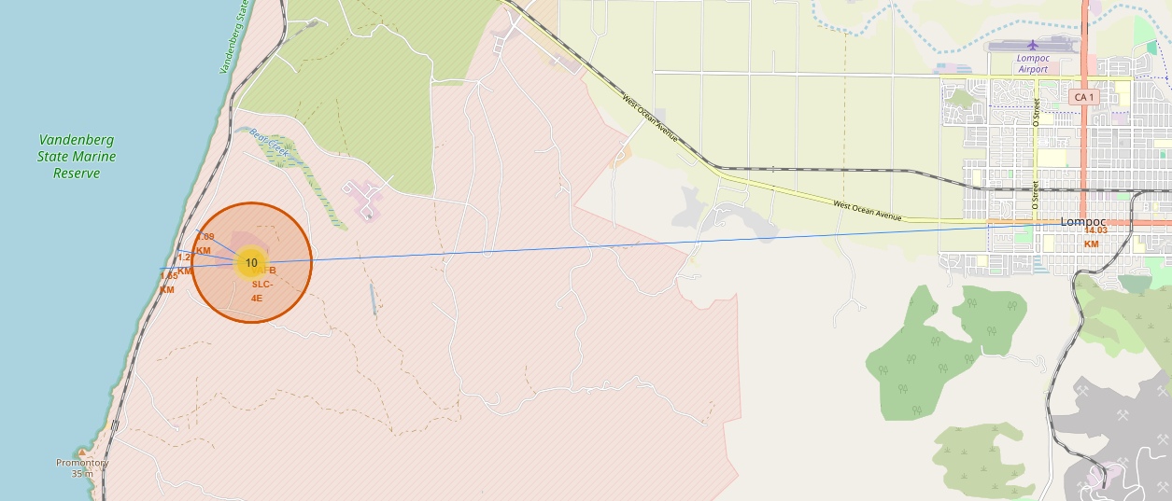
Closest coastline, railway and city.
The closest city to the VAFB SLC-4E launch site is Lompoc, California with 14.03 KM.

Slide 37

Section 4

Slide 38
<Dashboard Screenshot 1>
Replace <Dashboard screenshot 1> title with an appropriate title
Show the screenshot of launch success count for all sites, in a piechart
Explain the important elements and findings on the screenshot

Slide 39
<Dashboard Screenshot 2>
Replace <Dashboard screenshot 2> title with an appropriate title
Show the screenshot of the piechart for the launch site with highest launch success ratio
Explain the important elements and findings on the screenshot

Slide 40
<Dashboard Screenshot 3>
Replace <Dashboard screenshot 3> title with an appropriate title
Show screenshots of Payload vs. Launch Outcome scatter plot for all sites, with different payload selected in the range slider
Explain the important elements and findings on the screenshot, such as which payload range or booster version have the largest success rate, etc.

Slide 41

Section 5

Slide 42
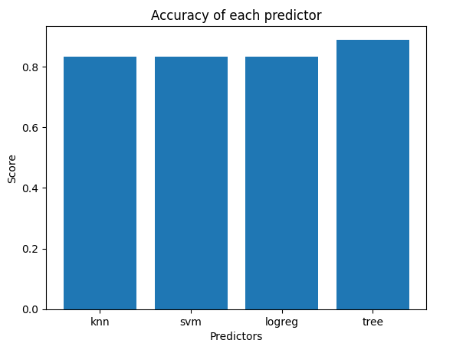
Classification Accuracy
The model with the highest accuracy is a decision tree

Slide 43
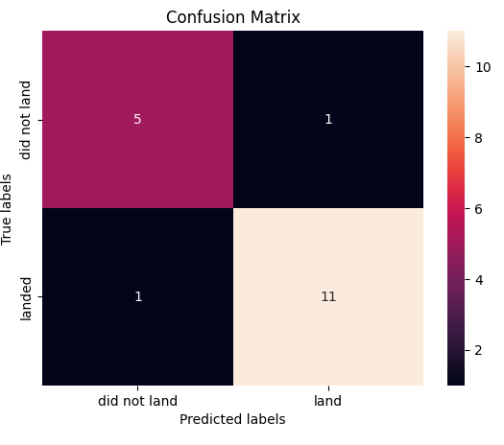
Confusion Matrix
Decision Tree

Slide 44
Conclusions
Web Scrapping was used to collect the data. It was transformed into a Data Frame
To choose the target label, EDA was done. Different types of outcomes were simplified into good outcome and bad outcome.
EDA with visualization showed that GTO as the most successful launches
EDA with SQL was done to understand the relation between dates, launch sites, payload, outcome.
Folium was used to create a map of launch sites
A dashboard was created to show pie charts and line charts of success rate
The decision tree classifier was the best classifier for this task,

Slide 45


